Slide 1
Playground News
TigerHacks 2018 Hackathon

Slide 2
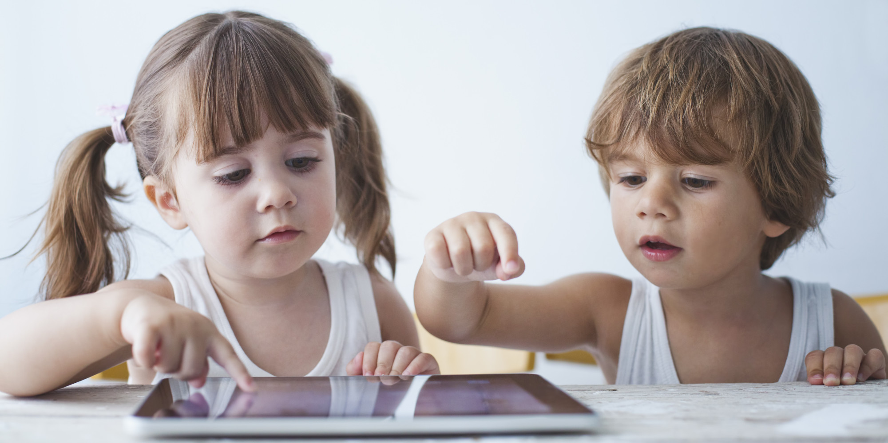
Motivation
We feel that many families own a shared iPad that their kids use from time to time
We were motivated to create some sort of app that would be used by each kid in the family to increase access to news and other journalism sources

Slide 3
Our Solution

Slide 4

Goals:
Display curated, age appropriate, vetted articles for each reader
Encourage reader to be engaged for a set amount of time
Allow for exploration of a variety of topics
Give parents a view to see child's reading statistics
Amount of time read per day per week
Popular topics child is reading
Most recent articles read

Slide 5
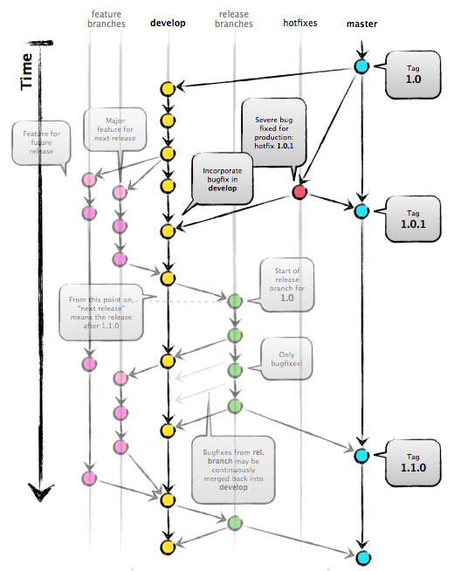

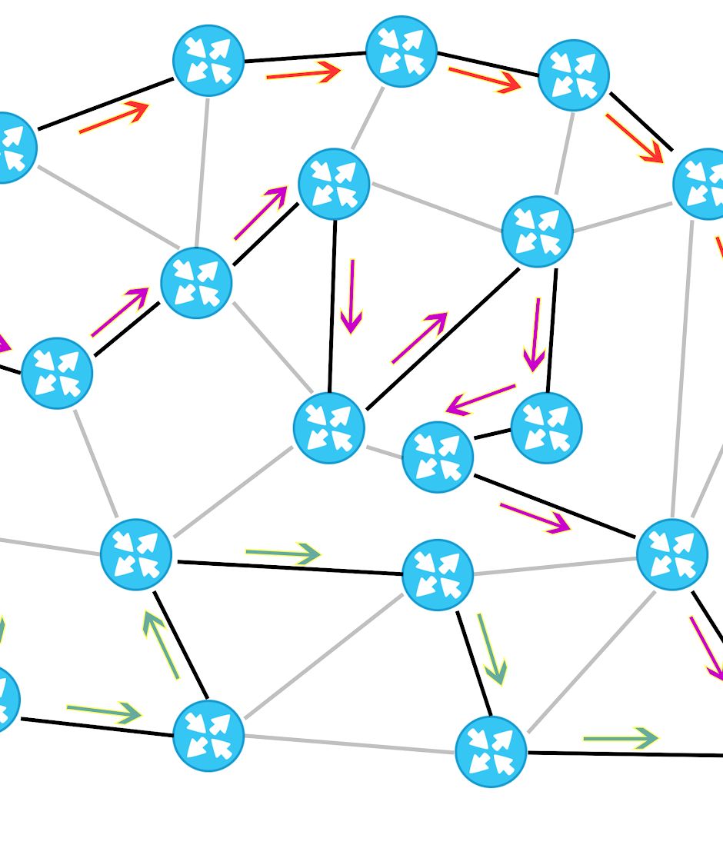
Early Obstacles
Learning Django, sqlite3, and React
Huge time sinks with syncing codebase with Git
Combining existing Django and React REST APIs for routing to different sources
Getting views created early on

Slide 6
Results

Slide 7
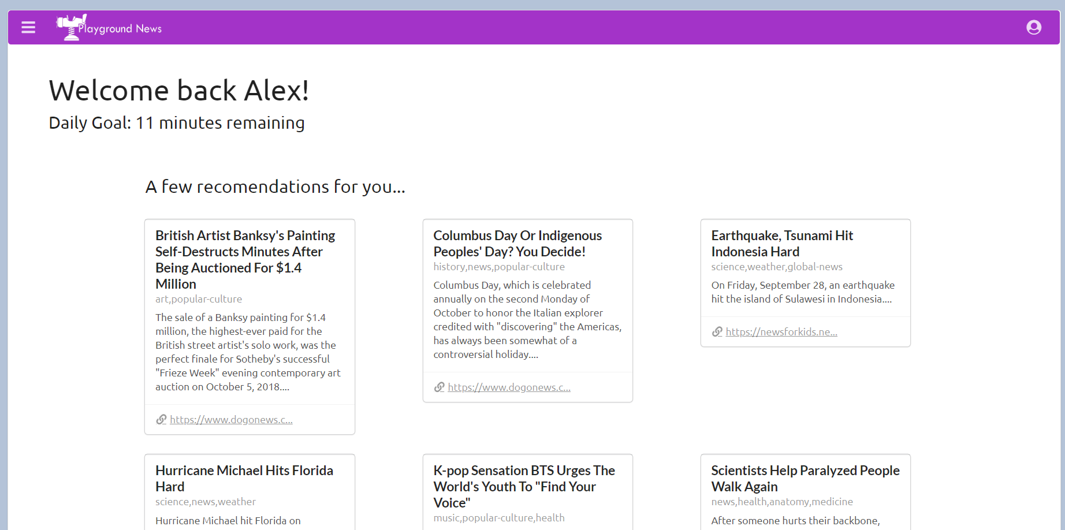

Slide 8
Real Life Application
We could use this for kids with different learning styles
Curate content that allows for flash games and videos to be embedded in the website
Classrooms could use the app to encourage reading
Point system added to 'game-ify' and further promote engagement in content
Parents could use the stats to have conversations with their children about what they're reading
Parents can also see what topics their children are interested in and become a bigger part of their exploration of that subject

Slide 9

What We Learned
Time management
Another frontend dev would have been swell
When we needed the views, we only had 1 person able to produce what we needed
Git Kraken can be difficult to use with a database
Better to do more research before getting a start on the actual code
Commit EARLY AND OFTEN!

